Slide 1
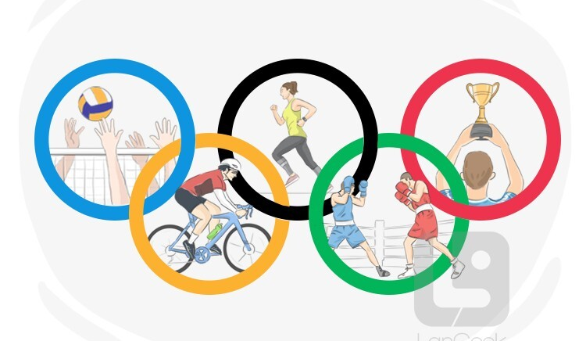

Roll no: 537/23
College: Mehr Chand Polytechnic College
Stream: Computer Science

Slide 2

Certification: ISO 9001:2015 Certified
Specializations:
- Web Development
- Mobile Application Development
- Custom Software Development
- UI/UX Design
- Hosting Services
- Digital Marketing
Services:
- Advanced IT solutions supporting the entire business
- Consulting to system development
- Deployment
- Quality Assurance
- 24x7 Support
Headquarters: Jalandhar
Branch Office: Hoshiarpur
Company Profile

Slide 3

Table of Content
Drawback of Existing System Project Explanation
Modules
Advantages of project
DFDs
Technology Used
Requirements
Screenshots
Conclusion
Future work
Thankyou

Slide 4

Drawback of Existing System
Limited Use Of Modern Technology For Athlete Performance Tracking
Delay In Real-time Data Updates During Events
Lack Of Proper Security For Athlete And Event Data
Low Audience Engagement Through Digital Platforms

Slide 5
Project Explanation

Slide 6

Project Modules
Admin Module
Customer Module

Slide 7

Advanced Performance Tracking
Improved Digital Engagement
Enhanced Data Security
Real-Time Data Updates

Slide 8

The modern approach to Olympics management enhances performance, ensures data security, and boosts audience engagement. It overcomes the limitations of the existing system using technology-driven solutions..

Slide 9


Future Scope
Integration of AI for predictive analysis
Use of VR/AR for immersive audience experience
Blockchain for secure data handling
Global data-sharing platforms for athlete development

Slide 10


